Slide 1
BDT - TradeData project
May 21, 2018

Slide 2



The Team
Professor
Student 1
Student 2
MRUDULA MUKADAM
Hoang Phuong Le
986305
Quoc Nghiep Nguyen
986375

Slide 3
Overview
• UNDERSTANDING CRYPTO-CURRENCIES TRADING MODEL
• USING SPARK STREAMING TO STREAM DATA
• USING HIVE/HBASE TO STORE DATA
• USING SPARK SQL TO ANALYZE DATA
• USING TOOL TO VISUALIZE DATA
• DEMO

Slide 4
Understanding the problem
BUYER MAKES BID
BITTREX MATCHES BID vs ASK
SELLER MAKES ASK
Price: at what price he wants to buy
Quantity: how many coin(s) he wants to buy
Ops: Confirm the bid and wait for the broker (bittrex) to match
Bittrex matches closest buyers’ highest BID and sellers' lowest ASK basis
When match found, Bittrex dequeues the bid/ask and pay corresponding amount to buyer/seller
Price: at what price he wants to sell his coin(s)
Quantity: how many coin(s) he wants to sell
Ops: Confirm the ask and wait for the broker (bittrex) to match

Slide 5

Project Objective
Produce a visualization tool to support user (buyer/seller) make decision when to bid (buy) or ask (sell)
Maximize profit

Slide 6
Understanding the market

Slide 7
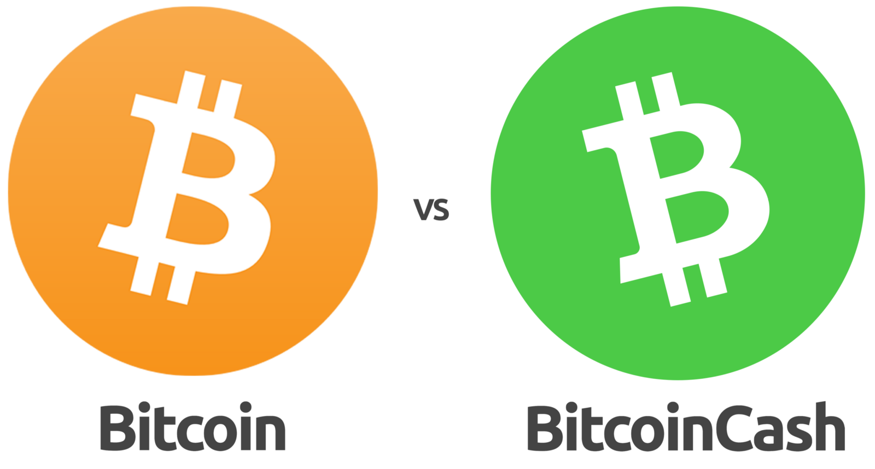
Target market
Bitcoin: 1 BTC ~ 8.750 USD
Bitcoin Cash: 1 BCC ~ 1.271 USD
BTC/BCC ~ 0.149225

Slide 8
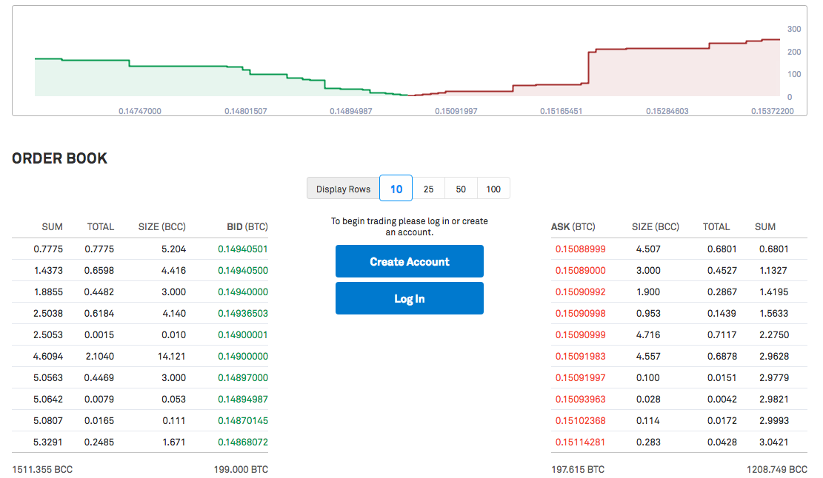
Trend for Buyers
Buy as cheap as possible
Trend for Sellers
Sell as high as possible

Slide 9
Components
Dataset
BITTREX
https://bittrex.com/api/v1.1/public/getmarkethistory?market=BTC-BCC
2. Spark Streaming
Producer pulls SELL-BUY data from BITTREX.COM
Consumer pushes SELL-BUY data to HBase
3. Hive/HBase
Use HIVE to query HBase
Use SparkSQL to query Hive
4. Zeppelin Chart
Display result as graphs

Slide 10




Data Flow
JSON
INSERT
Deployment
QUERY

Slide 11

Demo

